Slide 1

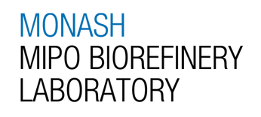

FYP A Interview (Week 8)
NAME: Goh Su Yuin
STUDENT ID: 33521301
PROJECT NAME: Valorization of Palm Kernel Shell-Derived Bio-Oil via One-Pot Esterification and Azeotropic Distillation for Marine Fuel Blending

Slide 2
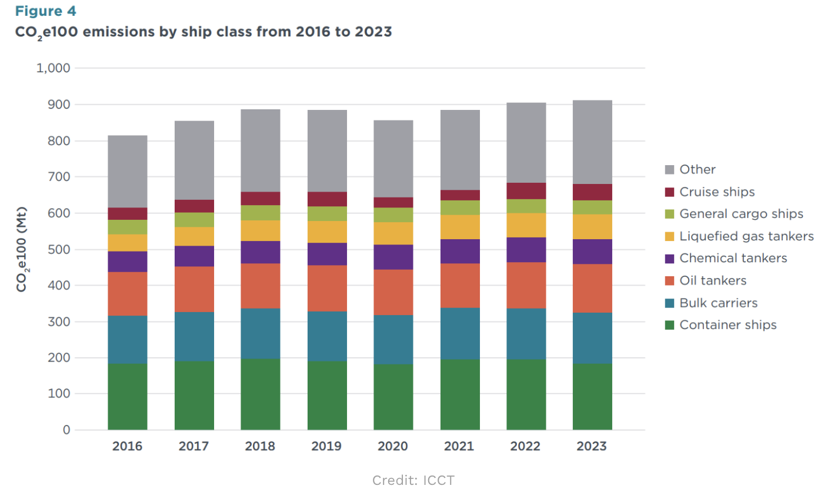
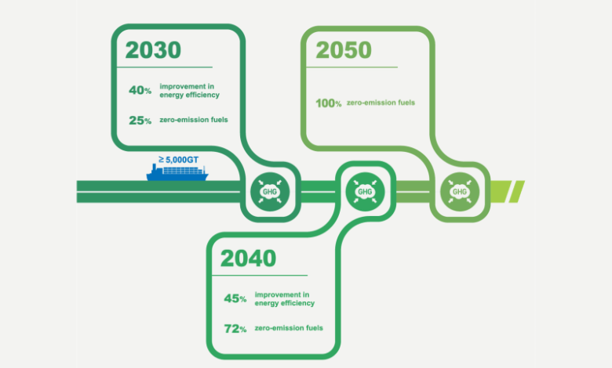
INTRODUCTION
Maritime industry heavily dependent on fossil fuels
Total greenhouse gas emissions (GHG) rose by 2.1% in 2025 [1]
Figure 1: CO2 emissions by global maritime class [3]
Figure 2: International Maritime Organization (IMO) GHG Strategy targets [2]
Growing need for alternative and lower carbon marine fuels
References:
[1] https://www.engine.online/news/eu-maritime-emissions-rose-in-2025-as-more-ships-entered-mrv-reporting-scope-7e85
[2] https://maritime-professionals.com/understanding-the-2023-imo-hgh-strategy/
[3] https://safety4sea.com/icct-global-ghg-emissions-from-shipping-2016-2023/

Slide 3
EXISTING STRATEGIES
The two common alternative fuels for decreasing maritime GHG emissions:
Methanol
High production cost [1].
Lower energy density [1].
Requires specific engine modifications and lubricants [1].
Toxicity and flammable concern [1].
Ammonia
Lower energy density [2].
Requires specific engine modifications and lubricants [3].
Toxicity and corrosive concern [2].
Produces harmful exhaust pollutants (Nitrogen Oxides) [2].
Need to explore alternative fuel options
References:
[1] https://mr-marinegroup.com/methanol-fuel-advantages-and-disadvantages/
[2] https://www.wartsila.com/insights/article/ammonia-fuel-for-thought-in-our-deep-dive
[3] https://www.marineinsight.com/introduction-to-ammonia-as-a-potential-marine-fuel/

Slide 4
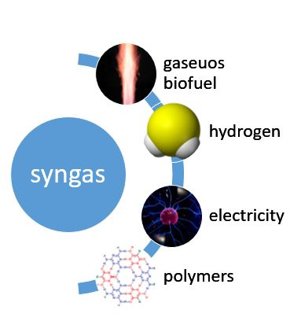
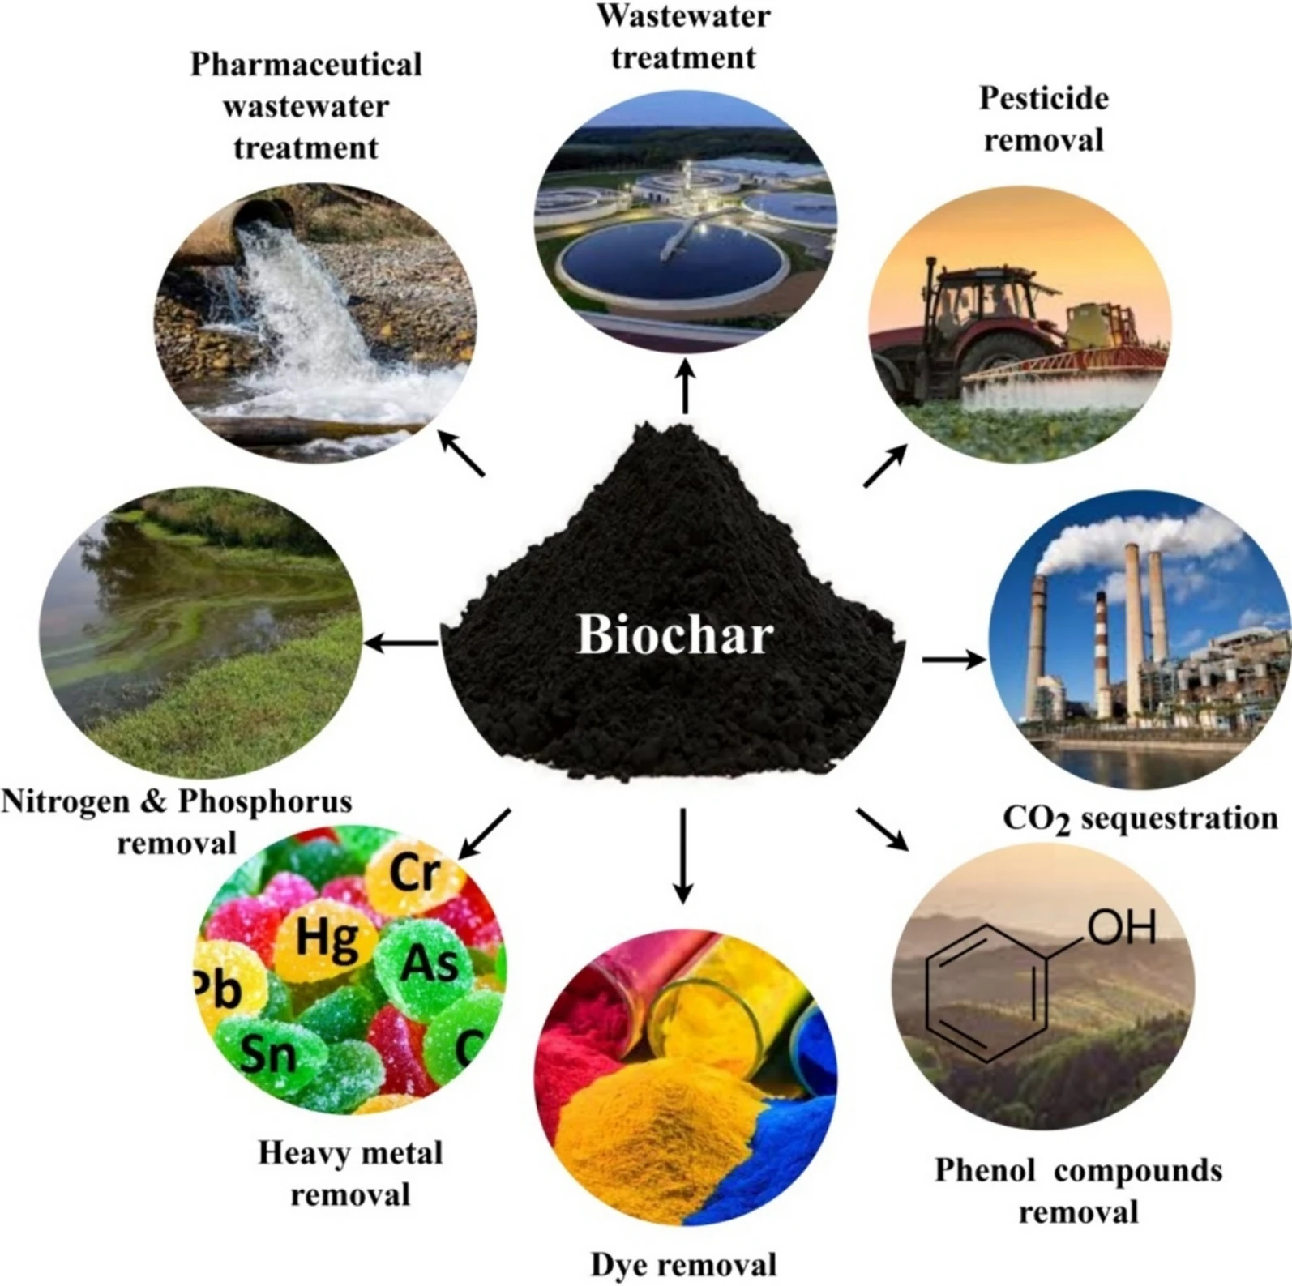
PROPOSED METHOD
Bio-oil blending:
Lowest-friction route to regulatory compliance [3].
No major engine modification needed [3].
https://pyrotechenergy.com/syngas/
Pyrolysis converts biomass waste into:
  Syngas
  Pyrolysis bio-oil (PBO)
  Biochar
Crude PBO characteristics [1]:
  High acidity
  High water content
Palm kernal shell (PKS)-derived PBO chosen as feedstock due to its abundant biomass availability in Malaysia [4]
https://link.springer.com/article/10.1007/s42773-024-00350-1/figures/6
References:
[1] https://pubs.acs.org/acsodf/article/8/47/44586/341370/Upgrading-Pyrolysis-Bio-Oil-through-Esterification
[3] https://marineinspection.app/blog/alternative-marine-fuels-lng-methanol-ammonia-hydrogen-shipping
[4] https://jopr.mpob.gov.my/pilot-scale-biochar-production-from-palm-kernel-shell-pks-in-a-fixed-bed-allothermal-reactor/

Slide 5
LITERATURE REVIEW
Bio-oil upgrading methods:
Hydrotreatment [1] | Catalytic Cracking [2] | Esterification [3]
Reacts bio-oil with H₂ gas over a catalyst to remove oxygen, forming a stable hydrocarbon fuel. Limitations: high pressure/temperature, H₂ supply, expensive catalysts. | Uses solid acid catalysts at high temperature to break large oxygenated acids into smaller hydrocarbons. Limitations: high temperature; risk of coke formation on catalyst. | A simpler, cheaper route converting carboxylic acids into less corrosive esters using alcohol. Limitations: forms excess water as a byproduct, which inhibits the reaction and limits conversion.
Esterification: Acid + Alcohol ⇌ Ester + Water
References:
[1] https://www.sciencedirect.com/science/article/pii/S0378382016301047
[2] https://www.sciencedirect.com/science/article/pii/S2772443322000186
[3] https://pmc.ncbi.nlm.nih.gov/articles/PMC13502472/

Slide 6
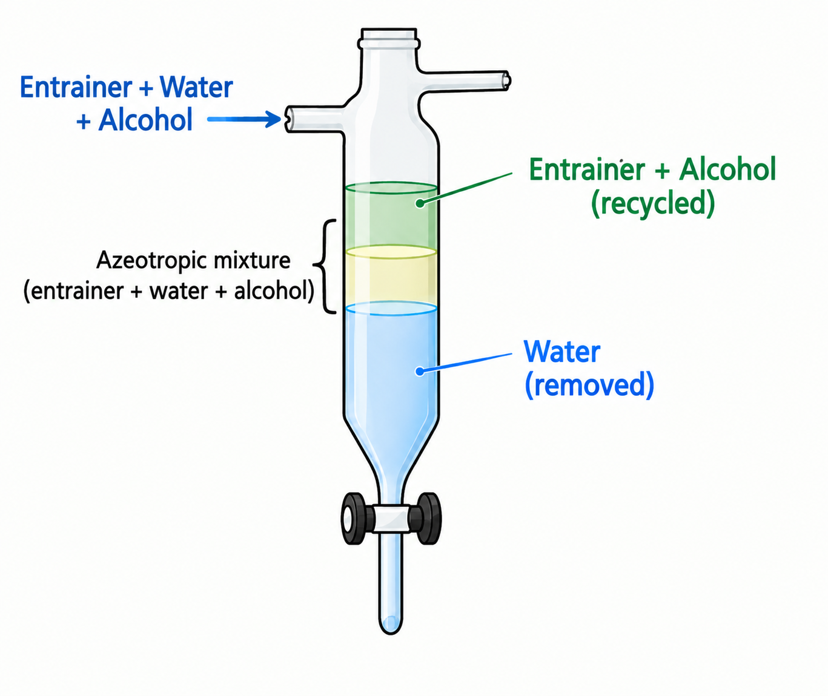
LITERATURE REVIEW
Water removal:
Molecular Sieves / Adsorbents [1,2] | Membrane Pervaporation [3]
Solid materials (e.g., silica gel) selectively remove water molecules based on their tiny pore sizes and high polar affinity. Limitations: prone to clogging and fouling, requires thermal regeneration before reuse. | Hydrophilic membrane under vacuum to selectively removes water; effective for continuous processes. Limitations: expensive, prone to fouling.
Azeotropic Distillation [4]
Entrainer breaks the azeotrope of alcohol- water, allowing continuous distillation and recovery of alcohol. Well suited to continuous, one-pot operation.
References:
[1] https://www.jalonzeolite.com/how-do-molecular-sieves-work/
[2] https://www.sciencedirect.com/science/article/pii/S209580992500606X
[3] https://www.sciencedirect.com/science/article/pii/S1387181121000111
[4] https://pmc.ncbi.nlm.nih.gov/articles/PMC13502472/

Slide 7
LITERATURE REVIEW
Alcohol
Catalyst
Option | Key Consideration
1-Hexanol [1] | High BP (157°C) compared to water; act as entrainer Expensive, limited large-scale renewable production
Methanol [2,3] | Widely used in studies due to high reactivity Low BP (64.7°C) Rapid vapor generation
Ethanol [3,4] | Renewable and economical High BP (78.4°C) as compared to methanol, favourable for retention during azeotropic distillation
Option | Key Consideration
H₂SO₄ (liquid) | Widely used in industry, high activity [5] Causes corrosion and is hard to separate from bio-oil [6]
Amberlyst-15 (Sulfonic acid based; Solid) | Reusable, easily separated Lower acid-site density (≥4.7 eq/kg) → slower rate expected [7]
Amberlyst-36 (Sulfonic acid based; Solid) | Reusable, easily separated Higher acid-site density (≥5.40 eq/kg) → faster rate expected [7]
References:
[5] https://www.mdpi.com/1996-1073/5/8/2683
[6] https://pmc.ncbi.nlm.nih.gov/articles/PMC12347235/
[7] https://pubs.acs.org/iecred/article/50/3/1171/1219556/Kinetics-of-Catalytic-Esterification-of-Propionic

Slide 8
LITERATURE REVIEW
Entrainer
Type | Azeotropic BP with H₂O [8] | Key Consideration
Benzene | ~69.3°C | Traditional academic reference Highly carcinogenic
Ethyl acetate | ~70.4°C | Considered as greener, less-toxic polar solvent Partially miscible with water
n-Heptane | ~79.2°C | Widely used non-polar entrainer Higher azeotropic temperature → greater risk of thermal degradation, polymerisation, catalyst deactivation
Cyclohexane | ~69.8°C | Second-lowest azeotropic temperature Immiscible with water → clean phase separation with minimal thermal stress
References:
[8] https://www.homepages.ed.ac.uk/jwp/Chemeng/azeotrope/hetero.html

Slide 9
PROBLEM STATEMENT
Existing bio-oil esterification studies each miss part of the solution:
PKS-derived bio-oil: reported with H₂SO₄ (corrosive catalyst) and molecular sieves (batch water removal) [9]
No entrainer: water accumulates and reverse hydrolysis limits conversion [10]
With entrainer: reported on hardwood, wood and waste oils [11, 12]
No study was found that combine a solid acid catalyst, ethanol and an entrainer to upgrade PKS-derived bio-oil in a one-pot process.
RESEARCH GAP/ NOVELTY
Feedstock: PKS-derived PBO
Catalyst and alcohol: Amberlyst-36 and ethanol
Process: One-pot Dean–Stark esterification with cyclohexane to remove water continuously at ~70°C (lower thermal stress)
References:
[9] https://onlinelibrary.wiley.com/doi/10.1155/2017/8359238
[10] https://doi.org/10.1007/s10553-025-01876-1
[11] https://doi.org/10.1021/ef8009266
[12] https://doi.org/10.1021/acs.energyfuels.5c06144

Slide 10
AIM & OBJECTIVE
To develop a one-pot azeotropic esterification process for PKS-derived PBO to simultaneously reduce acid value and water content, enhancing its suitability as a low-carbon MFO component.
To investigate the effectiveness of ethanol and Amberlyst-36 in reducing acidity through esterification process
To evaluate the efficiency of cyclohexane (entrainer) in removing the water generated continuously and recover evaporated ethanol during esterification
To optimize the key operating parameters for reducing acid value and water content of bio-oil
To characterize and compare the physio-chemical properties of crude and upgraded bio-oil after optimization
References:

Slide 11
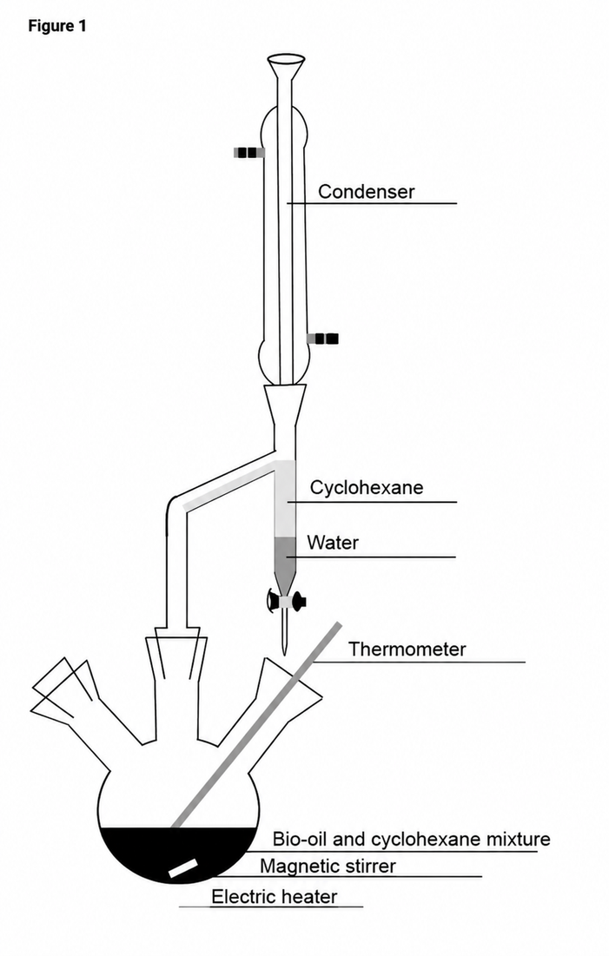
PROCEDURE
Range of operating conditions:
Mass of bio-oil: 100g
Mass of ethanol: 50g
Mass of cyclohexane: 30g
Temperature: 70°C
Catalyst dose: 0-2 wt%
Alcohol dose: 0-60wt%
Time: 1-24 hour
Pressure: 200-1013 mbar
Analytical Methods
Acid value: Acid-base titration
Water content: Karl-Fischer
Figure 5: One-pot Esterification and Azeotropic distillation from
References: Lindfors, T. Ohra-aho, and A. Oasmaa, “Quality Improvement of Biomass Pyrolysis Oil through Esterification,” Energy & Fuels, vol. 40, no. 33, pp. 18262–18273, Aug. 2026, doi: 10.1021/acs.energyfuels.6c01498.

Slide 12
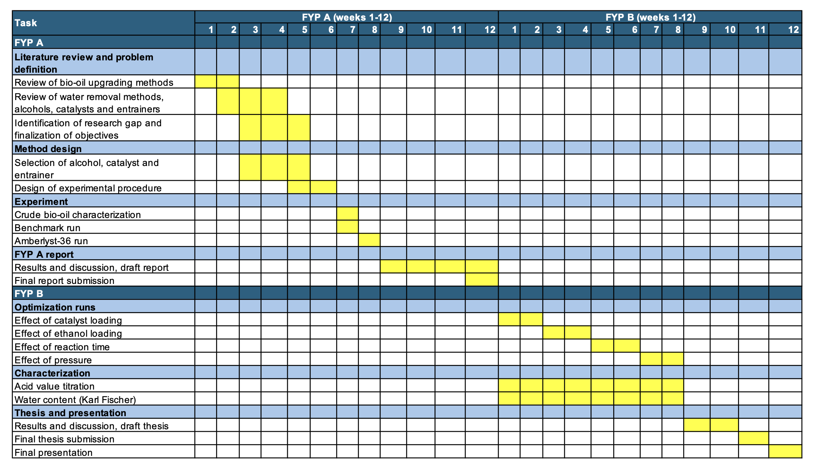
GANTT CHART
References:

Slide 13
EXISTING LITERATURE
1-Hexanol (act as entrainer & alcohol) + Amberlyst-36
>70% TAN reduction and marine-grade flash point achieved (Baser et al., 2026)
Methanol + H₂SO₄ (Without Entrainer)
96.95% acid value reduction (Khamhuatoey et al., 2023)
Methanol / Ethanol + Amberlyst-15 (Without Entrainer)
TAN reduced from 106.1 to 33.1 and 40.6 mgKOH/g, respectively (Ilin et al., 2025)
Ethanol + Amberlyst-15 + Cyclohexane
TAN reduced from 92 to 21 mgKOH/g (Moens et al., 2009)
Without entrainer: reverse hydrolysis dominates, preventing complete esterification.
With entrainer: water content significantly reduced
References:
Ilin, A. V., Burov, N. O., Rutskoy, M. D., Savelenko, V. D., Aleksanyan, D. R., Makhova, U. A., Vikhritskaya, A. O., Klimov, N. A., Lobashova, M. M., Kapustin, V. M., & Ershov, M. A. (2025). Enhanced Upgrading of Bio-Oil for Efficient Co-Processing in Refinery Delayed Coking Units. Chemistry and Technology of Fuels and Oils, 61(2), 365–371. https://doi.org/10.1007/s10553-025-01876-1
Luc, M., Black, S. K., Myers, M. D., & Czernik, S. (2009). Study of the Neutralization and Stabilization of a Mixed Hardwood Bio-Oil. Energy Fuels, 23(5), 2695–2699. https://doi.org/10.1021/ef8009266
Khamhuatoey, S., Kaewluan, S., Thawornprasert, J., Ye Min, O., Pongraktham, K., & Somnuk, K. (2023). Upgrading Pyrolysis Bio-Oil through Esterification Process and Assessing the Performance and Emissions of Diesel–Biodiesel–Esterified Pyrolysis Bio-Oil Blends in Direct Injection Diesel Engines. ACS Omega, 8(47), 44586–44600. https://doi.org/10.1021/acsomega.3c05007
Baser, B., Hansen, B. B., Morten Nedergaard, P., Anker Degn, J., Schulzke, T., & Jensen, P. A. (2026). Upgrading Wood and Waste Fast Pyrolysis Oils by Esterification. Energy Fuels, 40(12), 6171–6181. https://doi.org/10.1021/acs.energyfuels.5c06144

